Slide 1

Core Java
Lesson 1: Introduction to Java

Slide 2
Lesson Objective
Introduction to Java
Features of Java
Evolution of Java
Developing software in Java
Writing, Compiling and execution of Simple Java Program
Java Language Fundamentals

Slide 3
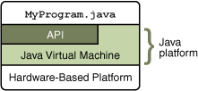
Introduction to Java
History of Java :
Developed: 1991 - Part of Sun's "Green Team Project
Created by: Patrick Naughton, Mike Sheridan, and James Gosling
Demo released: 1992
Released: 1995
Original name: Oak
Recent News:
* 2006 – Sun released much of java as open source software
* 2009 – 2010 – Oracle corporation acquired Sun Microsystems
About Java Technology:
Java is a high level programming language created by Sun Microsystems.
Java technology is both a programming language and a platform

Slide 4
Features of Java
Object Oriented : class, object, inheritance, polymorphism … etc
Simple : easy to learn
Robust : strongly typed
Secure : Byte code verifier, Security Manager …etc.
Architecture Neutral: Platform independent
Interpreted and Compiled
Multithreaded: Concurrent running tasks
Dynamic : run time linking of code [applet]
Memory Management and Garbage Collection

Slide 5
Developing software in Java
Java Development Kit(JDK)
The Java Developer’s Kit is distributed by Sun Microsystems. The JDK contains documentation, examples, installation instructions, class libraries packages and tools.
There are two installers available.
  JDK – Software development Kit – compile and run java program
  JRE – Java Runtime Environment – run java program [subset of JDK ]
How to Install Java?
  Download the latest Java Installable from
  http://www.oracle.com/technetwork/java/javase/downloads/index.html
Java Virtual Machine (JVM) : Platform Independent

Slide 6
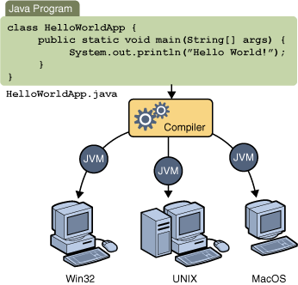
Writing, Compiling and Execution of Java Program
Java Virtual Machine (JVM)
  Java VM is available on many different operating systems. Hence the same .class files can be run on Microsoft Windows, the Solaris TM Operating System (Solaris OS), Linux, or Mac OS.

Slide 7

Writing, Compiling and Execution of Java Program
A Java program is written, compiled and executed in three steps.
  Step – 1: The source code is written in plain text file ending with .java extension.
  Step – 2 : The source files are compiled into .class files using javac compiler.
  Step – 3: The java launcher tool runs the application with an instance of JVM -
  Java Virtual Machine.

Slide 8
Writing, Compiling and Execution of Java Program
A Simple Java Program
class ExampleProgram {
public static void main(String[] args){
System.out.println("I'm a Simple Program");
}
}
Compiling the Program
javac ExampleProgram.java
Interpreting and Running the Program
Once the program successfully compiles into Java bytecodes, the Java interpreter is invoked at the command line on Unix and DOS shell operating systems as follows:
java ExampleProgram
Output : I'm a Simple Program

Slide 9
Java Language Fundamentals
Java Comments
  Single line Comment // comment statement
  Multiline Comment /* comment statement 1
  comment statement 2
  */
/* This Java class example describes how class is defined and being used in
Java language.
*/
public class JavaClassExample {
//main method – Entry Point
public static void main(String args[]){
//method call
System.out.println(“Hello World”);
}
}
OUTPUT : Hello World

Slide 10
Java Comments
Comments :
Comments are descriptions that are added to a program to make code easier to understand. The compiler ignores comments and hence its only for documentation of the program. Java supports three comment styles.
Implementation Comments:
Line style comments - begin with // and terminate at the end of the line.
Block style comments - begin with /* and terminate with */ that spans multiple lines.
Documentation comments
Begin with /** and terminate with */ that spans multiple lines. They are generally created using the automatic documentation generation tool, such as javadoc.

Slide 11
Data Types
Variables have a data type, that indicates the kind of value they can store.
Type
Size/Format
Description
byte
8-bit
Byte-length integer
short
16-bit
Short Integer
int
32-bit
Integer
long
64-bit
Long Integer
float
32-bit IEEE 754
Single precision floating point
double
64-bit IEE 754
Double precision floating point
char
16-bit
A single character
boolean
1-bit
True or False
Notes:
Page 03-<number>

Slide 12
Types of Variables
Basic storage in a Java program
Three types of variables:
  Instance variables
    Instantiated for every object of the class.
  Static variables
    Class Variables
    Not instantiated for every object of the class.
  Local variables
    Declared in methods and blocks.
Formal Parameters: Arguments passed to a function.
Notes:
Page 03-<number>

Slide 13
Types of Variables
    class emp {
    String name; //Instance Variable
    int empcode; //Instance Variable
    float basicsalary; //Instance Variable
    static int obcount; //static variable
    void calculateSalary() {
    float temp sal; //Local variable
    ….
    }
    } //class emp ends
Notes:
Page 03-<number>

Slide 14
Methods and Parameter Passing
Parameters or arguments passed to a function are
passed by value for primitive data-types.
Parameters or arguments passed to a function are passed by reference for non-primitive data-types
  Example: All Java objects.
void myFunction(Integer a) {
a++;
System.out.println(a);
}
….
Integer x = 45;
System.out.println(x);
myFunction(x);
System.out.println(x);
Output is, “45 46 45”
void myFunction(int a) {
a++;
System.out.println(a);
}
….
int x = 45;
System.out.println(x);
myFunction(x);
System.out.println(x);
Output is, “45 46 45”
Notes:
Page 03-<number>

Slide 15
Variable Argument List
New feature added in J2SE5.0.
Allows methods to receive unspecified number of arguments.
An argument type followed by ellipsis(…) indicates variable number of arguments of a particular type.
  Variable-length argument can take from zero to n arguments.
  Ellipsis can be used only once in the parameter list.
  Ellipsis must be placed at the end of the parameter list.
Notes:
Page 03-<number>

Slide 16
Variable Argument List
Valid Code
    void print(int a,int y,String...s)
    {
    //code
    }
print(1,1,”XYZ”) or print(2,5) or print(5,6,”A”,”B”) invokes
the above print function
Invalid Code
    void print(int a, int b…,float c)
    {
    //code
    }
Notes:
Page 03-<number>

Slide 17

Demo : Variable Argument List
Demo:
varargs.java
Notes:
Page 03-<number>

Slide 18
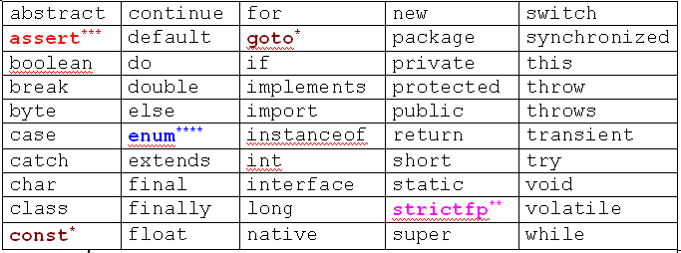
Keywords in Java
Keywords are reserved words can’t be used as variables, function and class names.
* not used *** added in 1.4
** added in 1.2 **** added in 5.0
Notes:
Page 03-<number>

Slide 19
Operators and Assignments Java
Operators can be divided into following groups:
  Arithmetic
  Bitwise
  Relational
  Logical
  instanceOf Operator
Notes:
Page 03-<number>

Slide 20
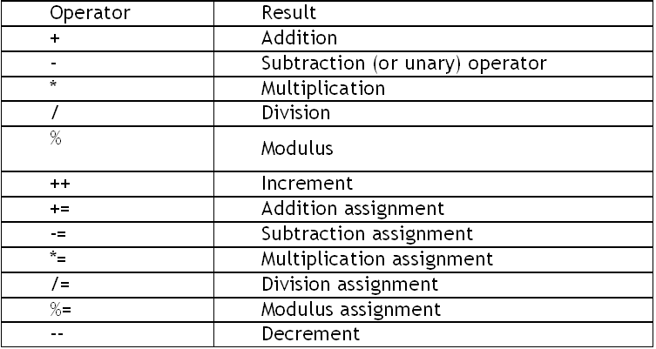
Arithmetic Operators
Notes:
Page 03-<number>

Slide 21
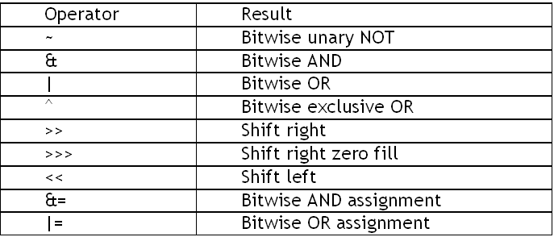
Bitwise Operators
Apply upon int, long, short, char and byte data types:
Notes:
Page 03-<number>

Slide 22
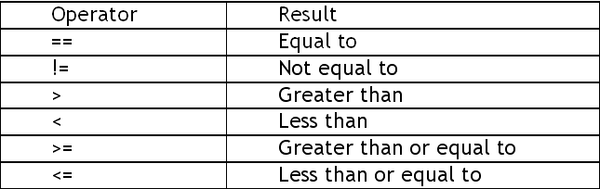
Relational Operators
Determine the relationship that one operand has to another.
  Ordering and equality.
Notes:
Page 03-<number>

Slide 23
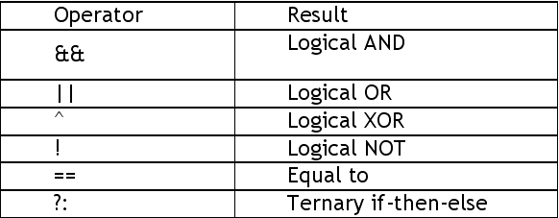
Logical Operators
Notes:
Page 03-<number>

Slide 24
instanceOf Operators
The instanceof operator compares an object to a specified type
Checks whether an object is:
  An instance of a class.
  An instance of a subclass.
  An instance of a class that implements a particular interface.
  The following returns true:
    new String("Hello") instanceof String;
Notes:
Page 03-<number>

Slide 25
Control Statements
Use control flow statements to:
  Conditionally execute statements.
  Repeatedly execute a block of statements.
  Change the normal, sequential flow of control.
Categorized into two types:
  Selection Statements
  Iteration Statements
Notes:
Page 03-<number>

Slide 26
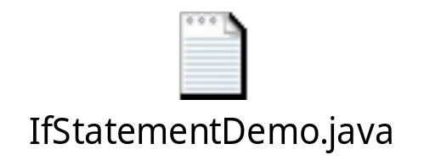
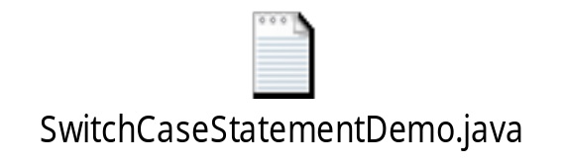
Selection Statements
Allows programs to choose between alternate actions on execution.
“If” used for conditional branch:
  if (condition) statement1;
  else statement2;
“Switch” used as an alternative to multiple “if’s”:
  switch(expression){
  case value1: //statement sequence
  break;
  case value2: //statement sequence
  break; …
  default: //default statement sequence
  }
Notes:
Page 03-<number>

Slide 27

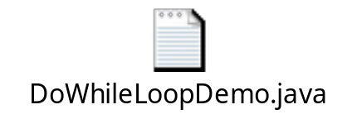

Iteration Statements
Allow a block of statements to execute repeatedly.
While Loop:
  Enters the loop if the condition is true.
    while (condition)
    { //body of loop }
Do – While Loop:
  Loop executes at least once even if the condition is false.
    do
    { //body of the loop
    } while(condition)
For Loop: for( initialization ; condition ; iteration)
    { //body of the loop }
Notes:
Page 03-<number>

Slide 28
Enhanced for Loop (foreach)
New feature introduced in Java 5.
Iterate through a collection or array.
  Syntax:
      for (variable : collection)
      { //code}
  Example
      int sum(int[] a)
      {
      int result = 0;
      for (int i : a)
      result += i;
      return result; }
Notes:
Page 03-<number>

Slide 29
Objects and Classes
Classes:
  A template for multiple objects with similar features.
  A blueprint or the definition of objects.
        class < class_name>
        {
        type var1; …
        Type method_name(arguments )
        {
        body
        } …
        } //class ends
Objects:
  Instance of a class.
  Concrete representation of class.
Notes:
Page 03-<number>

Slide 30
Introduction to Classes
Code Snippet:
class Box{
double width;
double height;
double depth;
double volume()
{
return width*height*depth;
} //method volume ends.
}//class box ends.
Notes:
Page 03-<number>

Slide 31
Declaring Objects
Code Snippet
class Impl{
public static void main(String a[])
{
//declare a reference to object
Box b;
//allocate a memory for box object.
b = new Box();
// call a method on that object.
b.volume();
}
}
Notes:
Page 03-<number>

Slide 32
Packages in Java
A Java package is a set of classes which are grouped together.
  To organize Java classes
  To code multiple Java classes with the same name.
Using Java Packages :
To use a package in your Java source code, you must either import the package or use the fully qualified class name each time you use a class.
Importing Classes :
import java.util.Date;
Or
Java.util.Date d = new java.util.Date();
All the classes in Java.lang package are automatically imported when the program runs. The rest of other classes in the packages are to be imported by the programmer by using the import keyword.

Slide 33

Demo: Creating Objects and classes
Demo:
Box.java
Notes:
Page 03-<number>

Slide 34
Constructors
Constructors are similar to methods except that constructors have the same name as the class . When a new instance (a new object) of a class is created using the new keyword, the constructor for that class is called. Constructors are used to initialize the instance variables (fields) of an object.
Default constructor. If we don't define a constructor for a class, a default parameterless constructor is automatically created by the compiler. The default constructor calls the default parent constructor (super()) and initializes all instance variables to default value (zero for numeric types, null for object references, and false for booleans).
Default constructor is created only if there are no constructors. If you define any constructor for your class, no default constructor is automatically created.
Differences between methods and constructors.
  Constructor does not have a return type
  There is no return statement in the body of the constructor.
  The first line of a constructor must either be a call on another constructor in the same class (using this), or a call on the superclass constructor (using super). If the first line is neither of these, the compiler automatically inserts a call to the parameterless super class constructor.

Slide 35
Constructor – Example program
Example of explicit this constructor call
public class Point {
int m_x;
int m_y;
//============ Constructor public
Point(int x, int y) {
m_x = x;
m_y = y;
}
//============ Parameterless default constructor
public Point() {
this(0, 0);
// Calls other constructor.
}
. . . }

Slide 36
Types of Class Members
Default access members (No access specifier)
  accessible only by classes in the same package
Private members
  cannot be accesses by anywhere outside the enclosing class
Public members
  are visible to any class in the Java program, whether these classes are in the same package or in another package.
Protected member
  only accessible by subclasses in same aa well as other packages
Notes:
Page 03-<number>

Slide 37
Memory Management
Dynamic and Automatic
No Delete operator
Java Virtual Machine (JVM) de-allocates memory allocated to unreferenced objects during the garbage collection process.
Notes:
Page 03-<number>

Slide 38
Enhancement in Garbage Collector
Garbage Collector:
  Lowest Priority Daemon Thread
  Runs in the background when JVM starts.
  Collects all the unreferenced objects.
  Frees the space occupied by these objects.
  Call System.gc() method to “hint” the JVM to invoke the garbage collector.
    There is no guarantee that it would be invoked. It is implementation dependent.
Notes:
Page 03-<number>

Slide 39
Memory Management
All Java classes have constructors.
  Constructors initialize a new object of that type.
Default no-argument constructor is provided if program has no constructors.
  Constructors:
    Same name as the class.
    No return type; not even void.
Notes:
Page 03-<number>

Slide 40
Finalize() Method
Memory is automatically de-allocated in Java.
Invoke finalize() to perform some housekeeping tasks before an object is garbage collected.
Invoked just before the garbage collector runs:
  protected void finalize()
Notes:
Page 03-<number>

Slide 41
Arrays
A group of like-typed variables referred by a common name.
Array declaration:
  int arr [];
  arr = new int[10]
  int arr[] = {2,3,4,5};
  int two_d[][] = new int[4][5];
Notes:
Page 03-<number>

Slide 42
Creating Array Objects
Arrays of objects too can be created:
  Example 1:
    Box Barr[] = new Box[3];
    Barr[0] = new Box();
    Barr[1] = new Box();
    Barr[2] = new Box();
  Example 2:
    String[] Words = new String[2];
    Words[0]=new String(“Bombay”);
    Words[1]=new String(“Pune”);
Notes:
Page 03-<number>

Slide 43
Creating Array Objects
Arrays of objects too can be created:
  Example 1:
    Box Barr[] = new Box[3];
    Barr[0] = new Box();
    Barr[1] = new Box();
    Barr[2] = new Box();
  Example 2:
    String[] Words = new String[2];
    Words[0]=new String(“Bombay”);
    Words[1]=new String(“Pune”);
Notes:
Page 03-<number>

Slide 44
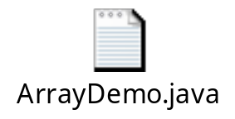
Demo : Creating Array Objects
Demo: ArrayDemo.java
Notes:
Page 03-<number>

Slide 45
Static variable
Static variable is shared by all the class members.
Used independently of objects of that class.
Static members can be accessed before an object of a class is created, by using the class name:
  Example:
    static int intNum1 = 3;
Notes:
Page 03-<number>

Slide 46
Static Methods
Restrictions:
  Can only call other static methods.
  Must only access other static data.
  Cannot refer to this or super in any way.
  Can not access non-static variables and methods directly:
    Explicit instance variables should be made available to the method.
    Method main() is a static method. It is called by JVM.
Notes:
Page 03-<number>

Slide 47
The Object Class
Cosmic super class.
Ultimate ancestor
  Every class in Java implicitly extends Object.
Object type variables can refer to objects of any type:
  Example:
  Object obj = new Emp();
Object Class Methods:
  void finalize()
  Class getClass()
  String toString()
Notes:
Page 03-<number>

Slide 48
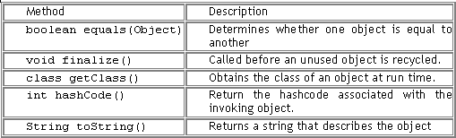
Object Class Methods
Notes:
Page 03-<number>

Slide 49
The System Class
Used to interact with any of the system resources.
Cannot be instantiated.
Contains a methods and variables to handle system I/O.
Facilities provided by the System class:
  Standard input
  Standard output
  Error output streams
Notes:
Page 03-<number>

Slide 50
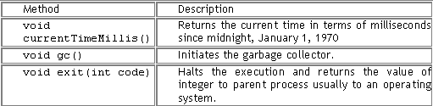
The System Class (contd..)
Notes:
Page 03-<number>

Slide 51
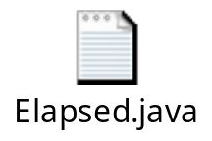
Demo : The System Class
Demo: Elapsed.java
Notes:
Page 03-<number>

Slide 52
String Handling
String is handled as an object of class String and not as an array of characters.
String class is a better and a convenient way to handle any operation.
One main restriction is that once an object of this class is created, the contents cannot be changed.
Notes:
Page 03-<number>

Slide 53
String Handling – Important Methods
length(): length of string.
indexOf(): searches an occurrence of a char, or string within other
string.
substring(): Retrieves substring from the object.
trim(): Removes spaces.
valueOf(): Converts data to string.
Notes:
Page 03-<number>

Slide 54
The String Class
String str = new String(“Pooja”);
String str1 = new String(“Sam”);
Heap Stack
Pooja
str
Sam
str1
String str = new String(“Pooja”);
String str1 = str;
str
Pooja
str1
Notes:
Page 03-<number>

Slide 55
String Concatenation
Use a “+” sign to concatenate two strings:
  String Subject = "Core " + "Java"; -> Core Java
  String concatenation operator if one operand is a string:
    String a = "String"; int b = 3; int c=7
    System.out.println(a + b + c); -> String37
  Addition operator if both operands are numbers:
    System.out.println(a + (b + c)); -> String10
Notes:
Page 03-<number>

Slide 56
String Concatenation (contd..)
public String concat(String s)
  Used to concatenate a string to an existing string.
  String x = "Core ";
  System.out.println( x=x.concat(" Java") );
  Output -> "Core Java”
Notes:
Page 03-<number>

Slide 57
String Comparison
    class EqualsNotEqualTo {
    public static void main(String args[]) {
    String str1 = "Hello";
    String str2 = new String(str1);
    System.out.println(str1 + " equals " + str2 + " -> " + str1.equals(str2));
    System.out.println(str1 + " == " + str2 + " -> " + (str1 ==str2));
    }
    }
    Output : Hello equals Hello -> true
    Hello == Hello -> false
Notes:
Page 03-<number>

Slide 58
StringBuffer Class
Use the following to make ample modifications to character strings:
  java.lang.StringBuffer
  java.lang.StringBuilder
Many string object manipulations end up with a many abandoned string objects in the String pool
  String Objects are immutable.
    StringBuffer sb = new StringBuffer("abc");
    sb.append("def");
    System.out.println("sb = " + sb); // output is "sb = abcdef"
Notes:
Page 03-<number>

Slide 59
StringBuilder Class
Added in Java 5.
Exactly the same API as the StringBuffer class, except:
  It is not thread safe.
  It runs faster than StringBuffer.
  StringBuilder sb = new StringBuilder("abc");
  sb.append("def").reverse().insert(3, "---");
  System.out.println( sb ); // output is "fed---cba"
Notes:
Page 03-<number>

Slide 60
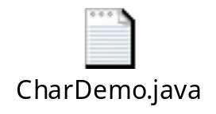
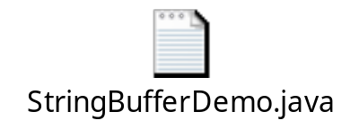
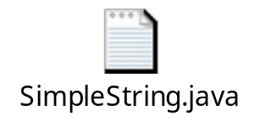
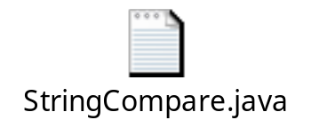
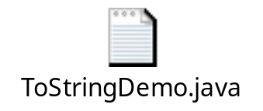
Demo : String handling
Demo:
SimpleString.java
ToStringDemo.java
StringBufferDemo.java
CharDemo.java
Notes:
Page 03-<number>

Slide 61
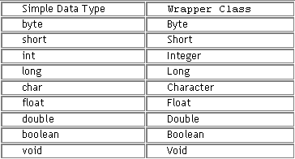
Wrapper Classes
Correspond to primitive data types in Java.
Represent primitive values as objects.
Wrapper objects are immutable.
Notes:
Page 03-<number>

Slide 62
Casting for Conversion of Data type
Casting operator converts one variable value to another where two variables correspond to two different data types.
  variable1 = (variable1) variable2
Here, variable2 is typecast to variable1.
Data type can either be a reference type or a primitive one.
Notes:
Page 03-<number>

Slide 63
Casting Between Primitive Types
When one type of data is assigned to another type of variable, automatic type conversion takes place if:
  Both types are compatible.
  Destination type is larger than the source type.
  No explicit casting is needed (widening conversion).
  int a=5; float b; b=a;
If there is a possibility of data loss, explicit cast is needed:
  int i = (int) (5.6/2/7);
Notes:
Page 03-<number>

Slide 64
Casting Between Reference Types
One class types involved must be the same class or a subclass of the other class type.
Assignment to different class types is allowed only if a value of the class type is assigned to a variable of its superclass type.
Assignment to a variable of the subclass type needs explicit casting:
  String StrObj = Obj;
Explicit casting is not needed for the following:
  String StrObj = new String(“Hello”);
  Object Obj = StrObj;
Notes:
Page 03-<number>

Slide 65
Casting Between Reference Types (contd..)
Two types of reference variable castings:
  Downcasting:
    Object Obj = new Object ( );
    String StrObj = (String) Obj;
  Upcasting:
    String StrObj = new String(“Hello”);
    Object Obj = StrObj;
Notes:
Page 03-<number>

